Slide 1
Coin Detection
Dr. Nada Dr. Younis

Slide 2
Agenda
Introduction
1
Library
2
Pre - Processing
3
Optimizer and Training of the model
4
Predict and Deployment
5

Slide 3
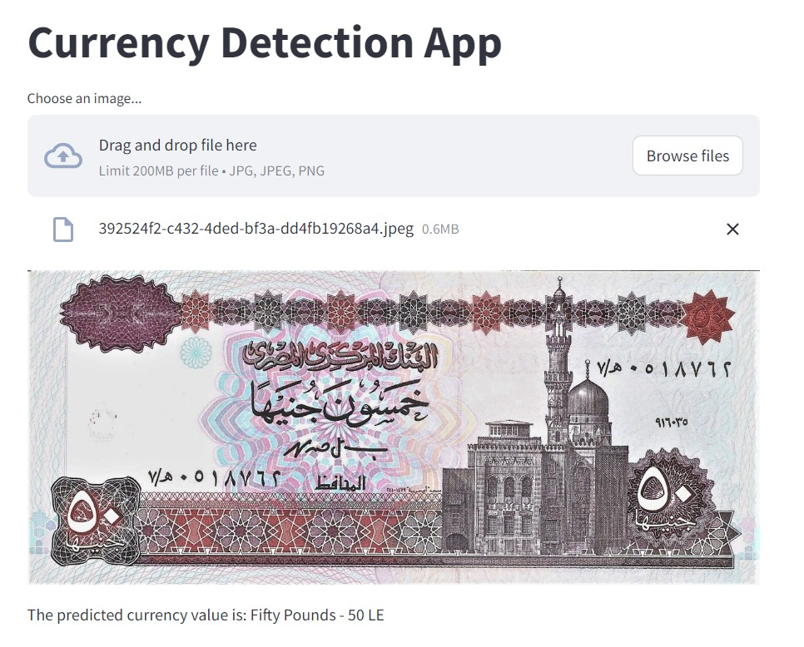
Introduction
3
The Model is currency recognition model using Convolutional Neural Networks (CNNs) in Keras. This model takes images of currency notes as input and predicts their denominations for output

Slide 4
Library

Slide 5
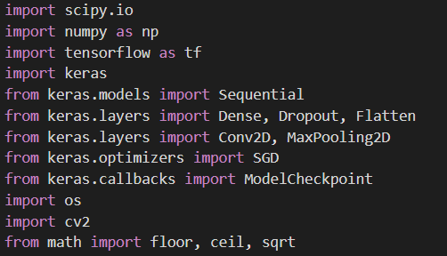
Libraries
The Keras deep learning library provides utilities for working with image data. The main API is the ImageDataGenerator class that combines data loading, preparation, and augmentation

Slide 6
Pre – Processing

Slide 7
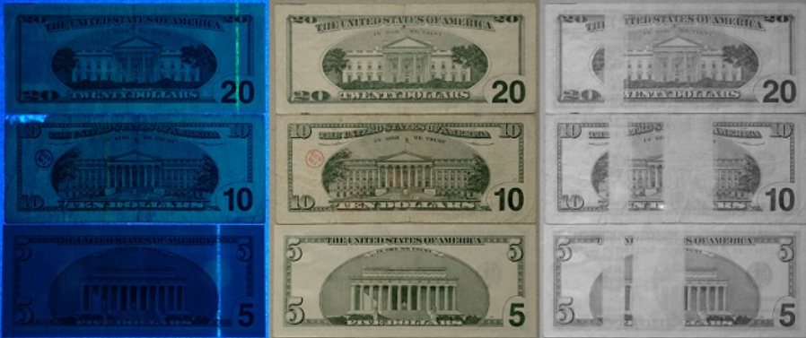
Pre - Processing
(1) Pre-definitions :
pre-definitions" likely refers to the initial setup or preparation steps that need to be taken before processing or analyzing images or videos

Slide 8
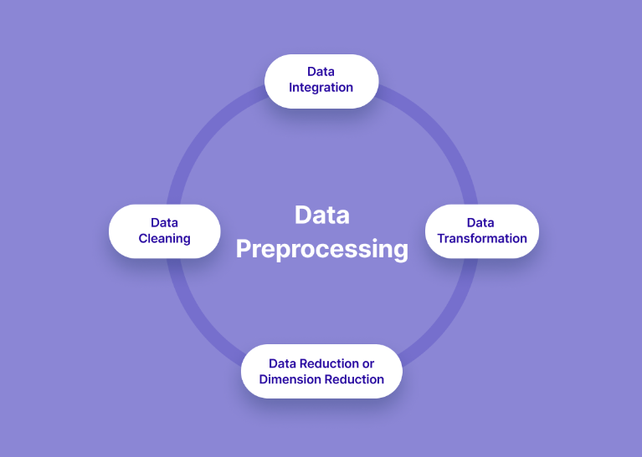
Pre - Processing
(2) Pre-processing :
Image preprocessing is the process of manipulating raw image data into a usable and meaningful format. It allows you to eliminate unwanted distortions and enhance specific qualities essential for computer vision applications. Preprocessing is a crucial first step to prepare your image data before feeding it into machine learning models

Slide 9
Optimizer and Training of the model

Slide 10
Optimizer
The optimizer is a fundamental component of training neural network models in computer vision. It plays a crucial role in controlling the training process, adjusting model parameters, and optimizing performance on tasks ranging from image classification to object detection and beyond.

Slide 11
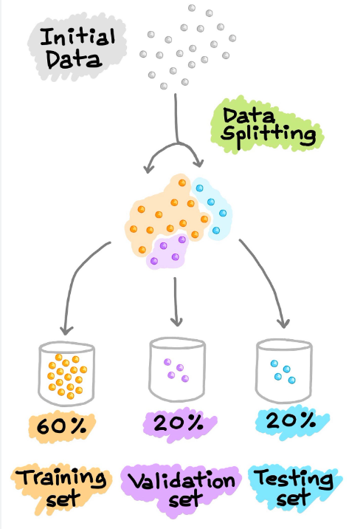
Training of the model
passing the training data and validation data along with how many examples to evaluate at a time "batch_size" and to loop over data how many times "epochs“and shuffle the data help for a faster convergence and better accuracies
model.fit(x_train, y_train, validation_data=(x_val,y_val), batch_size=32, epochs=5, verbose=2, shuffle=True, callbacks=[checkpoint,tbCallBack])

Slide 12
Predict and Deployment

Slide 13
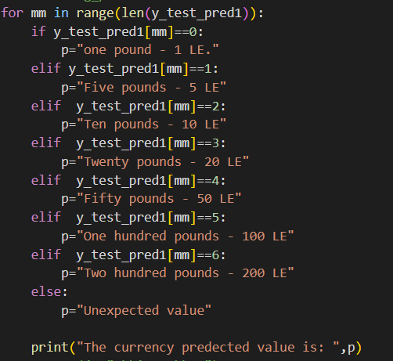
Predict and Deployment
Predict :
Predictive value in computer vision encapsulates the essence of extracting meaningful insights and understanding from visual data

Slide 14
Predict and Deployment
Deployment :

Slide 15
Thank you
Mohammed Abdelnasr Mahmoud Nagi Ziad Abdelmohsen Mohammed Assem

